Slide 1



Welcome to
Sticky Questions

Slide 2
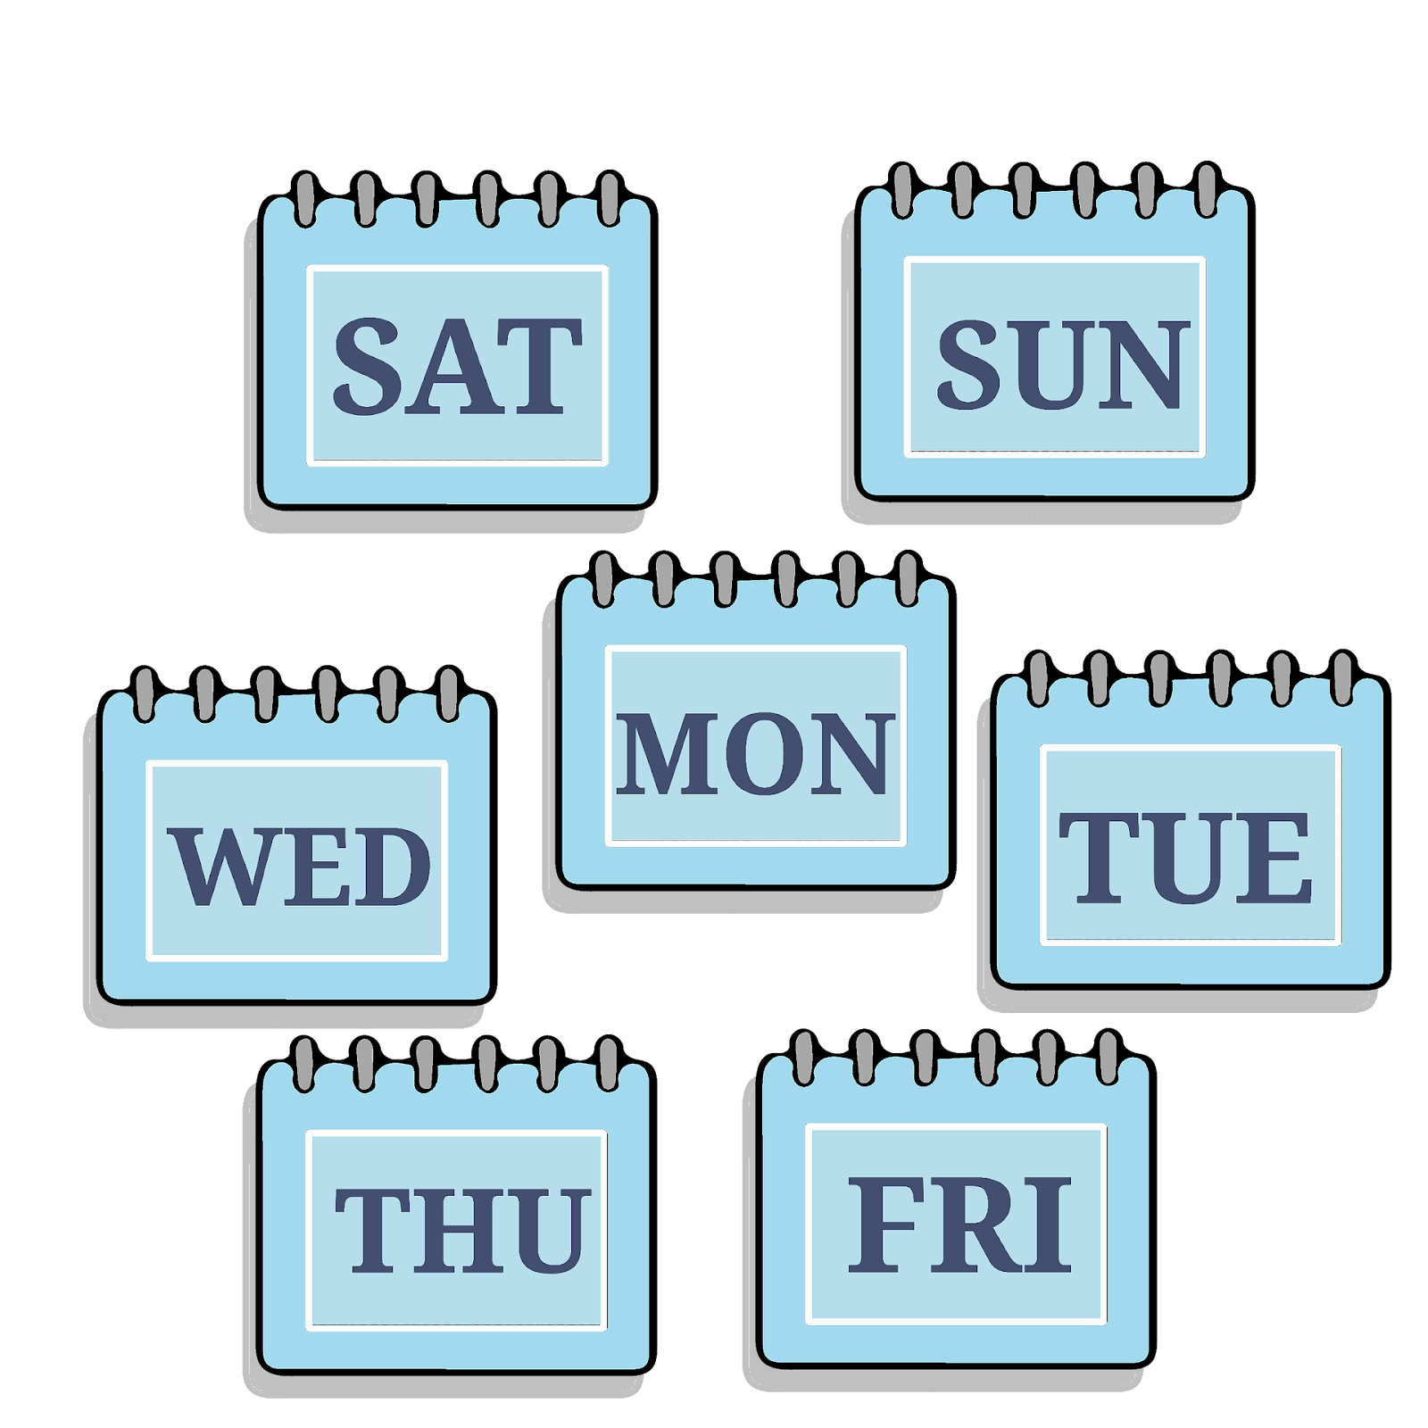
What’s the best day of the week?

Slide 3
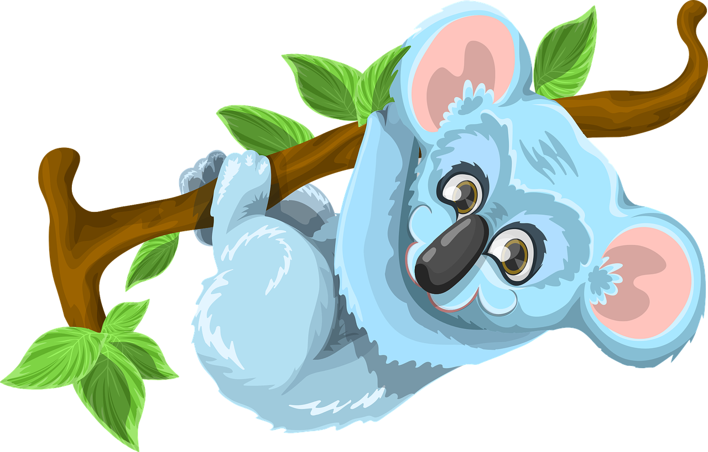
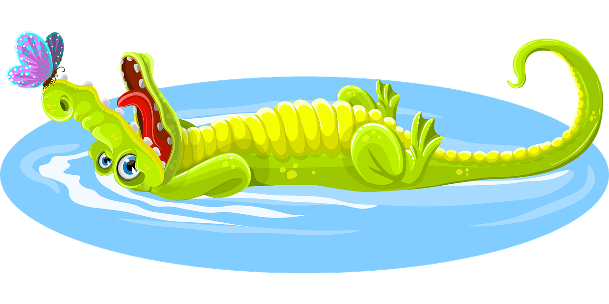
Would you rather live on water, or in the trees?

Slide 4
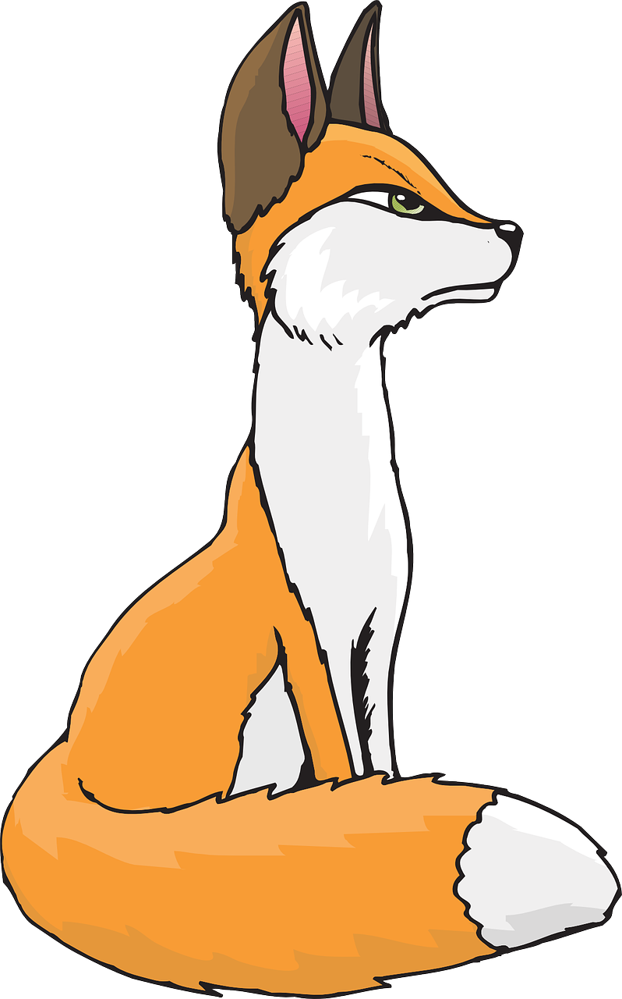
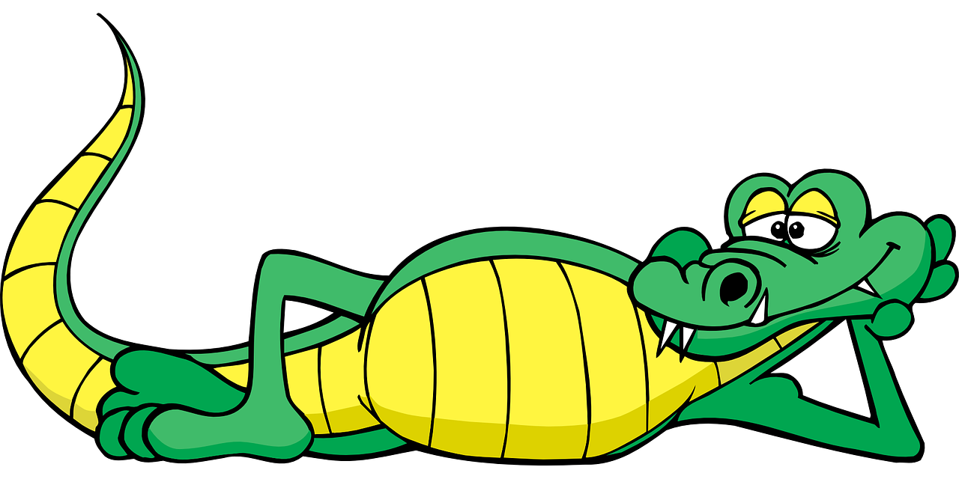
If you had a tail, what would you use it for?

Slide 5
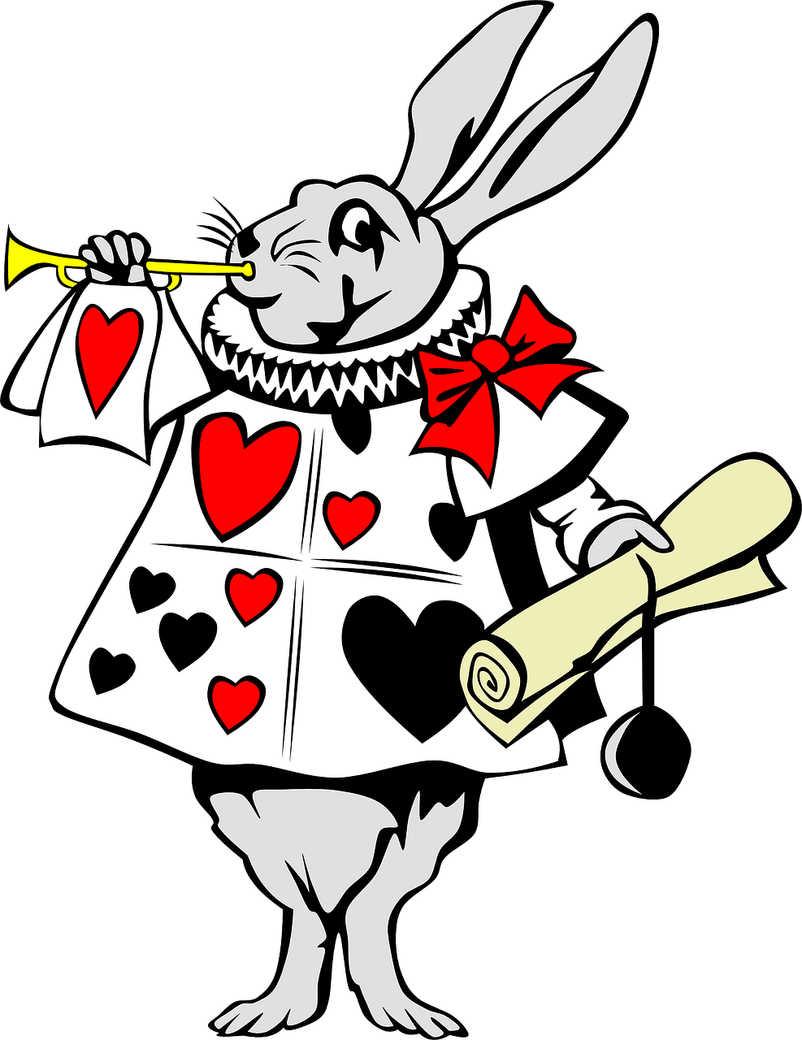
Would you rather live in an imaginary world than the real world?

Slide 6
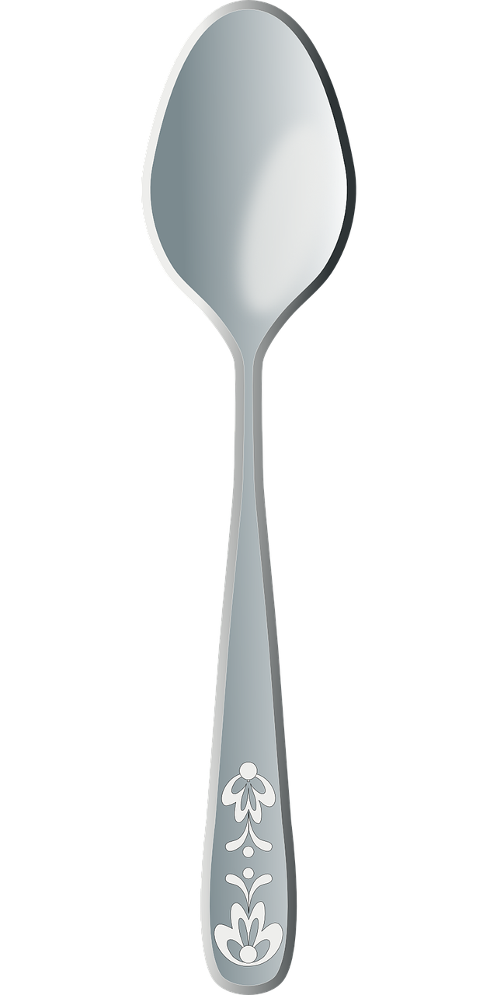
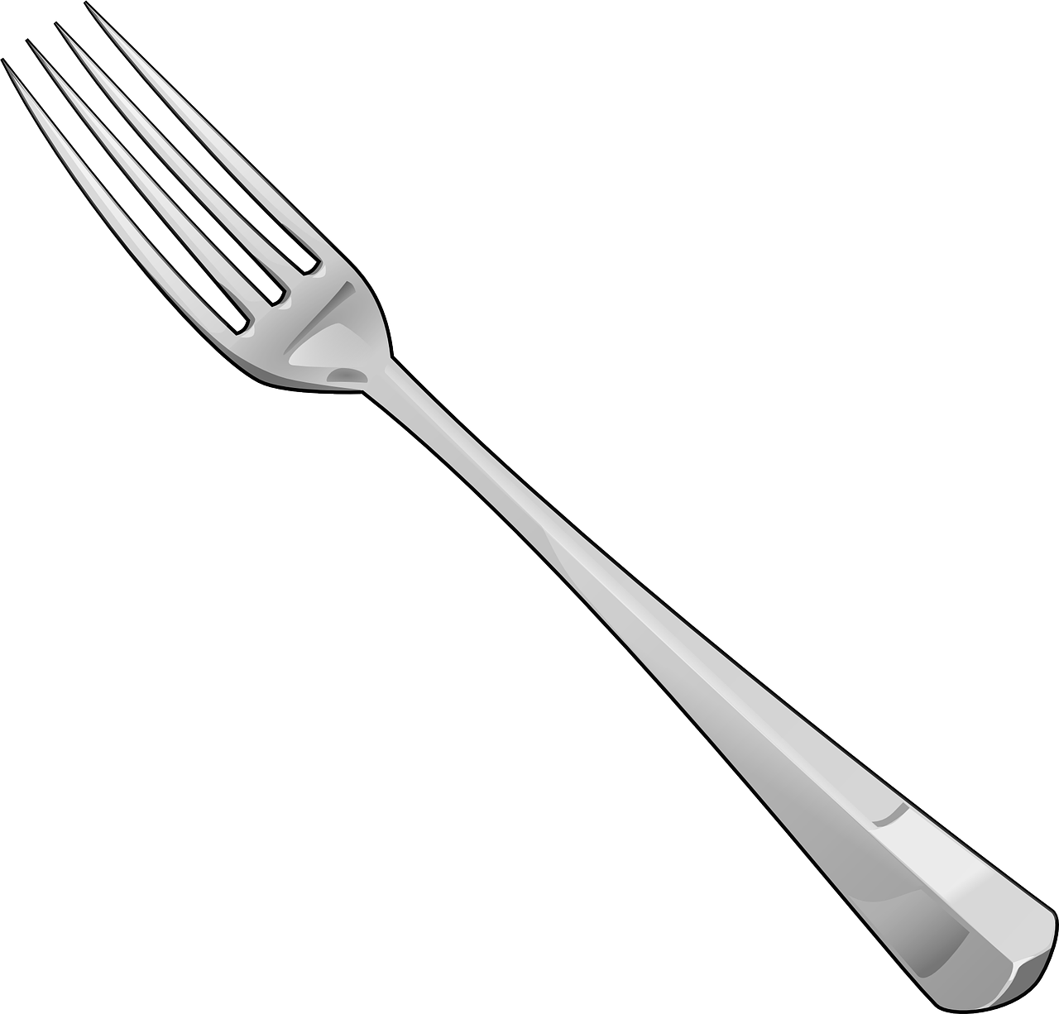
Would it be better to be a spoon, or a fork?

Slide 7
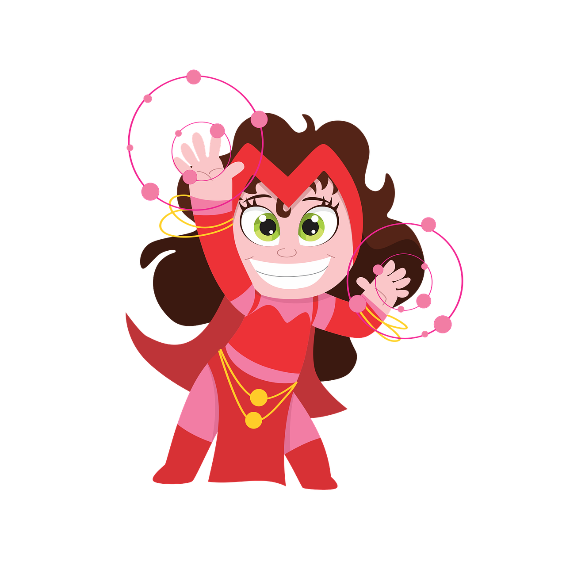
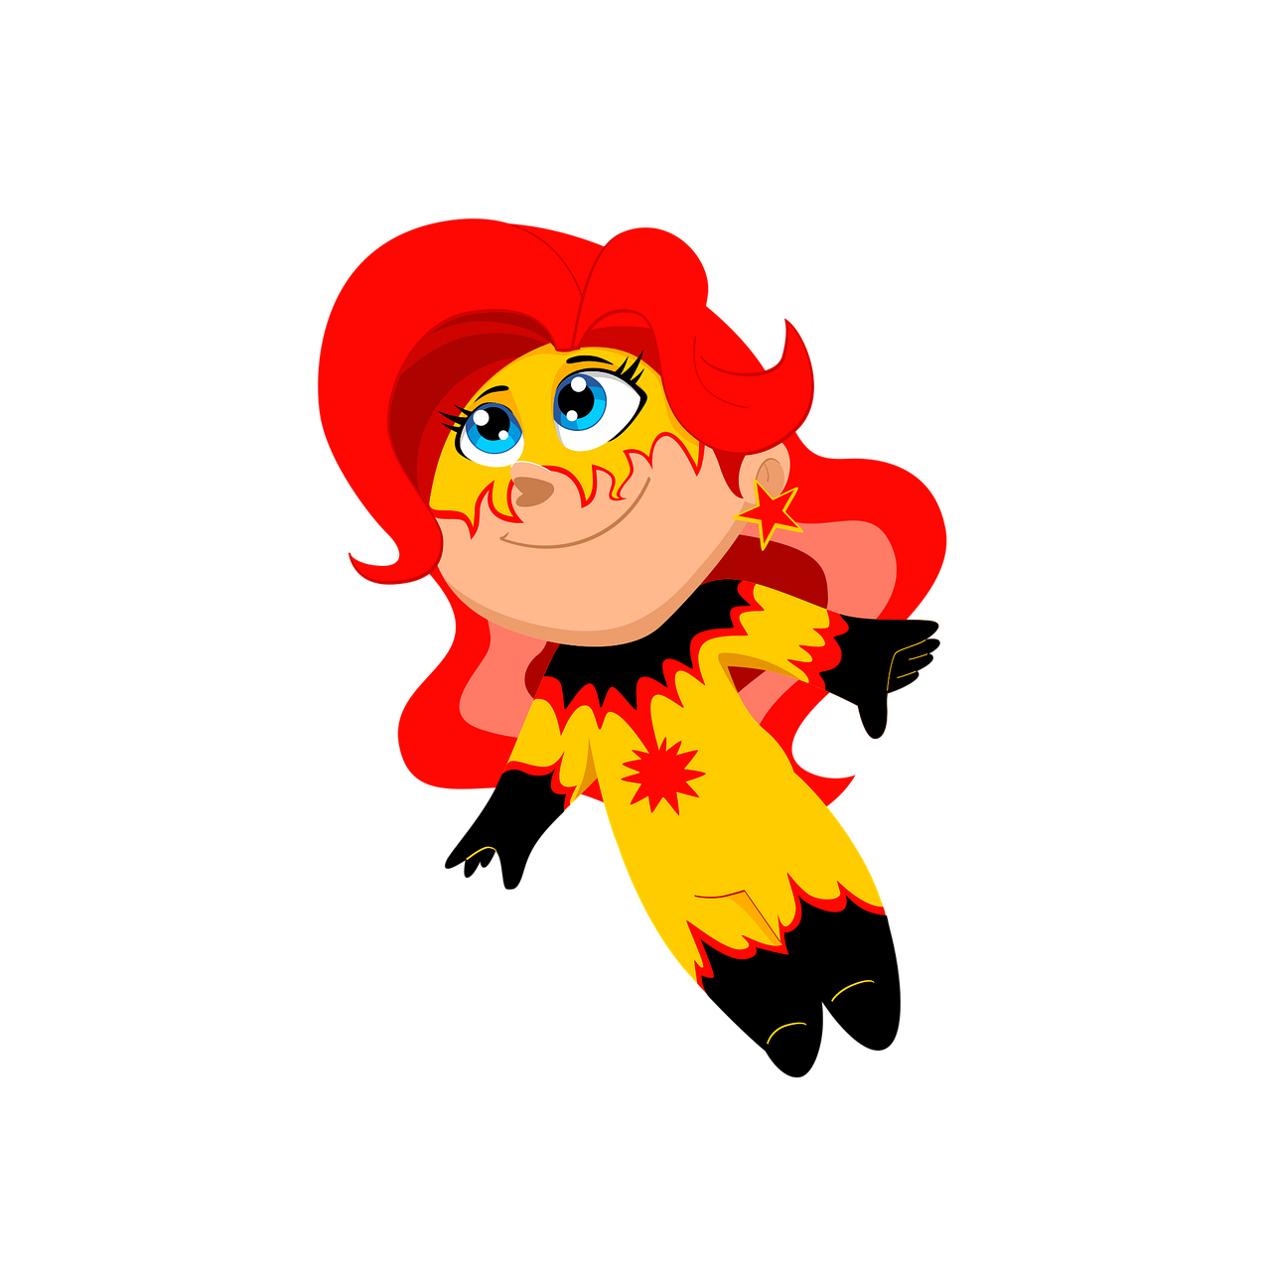
If your life was a story, how many heroes would it have?

Slide 8

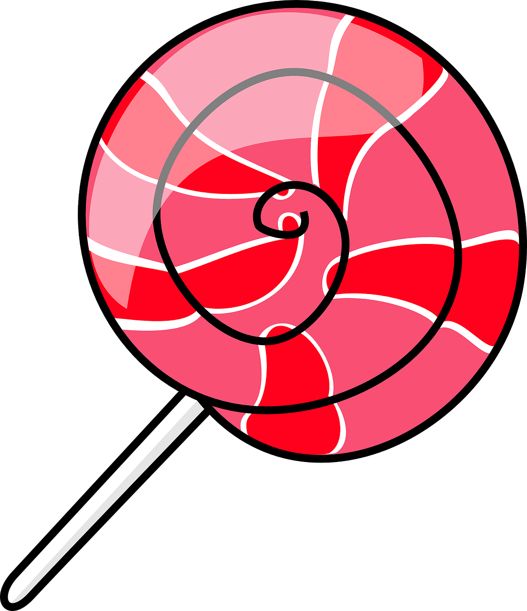

Can you ever have too much fun?

Slide 9
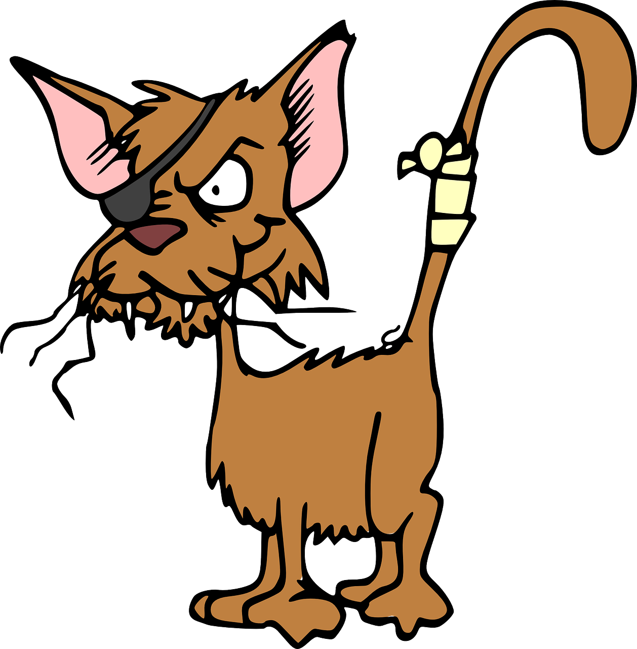
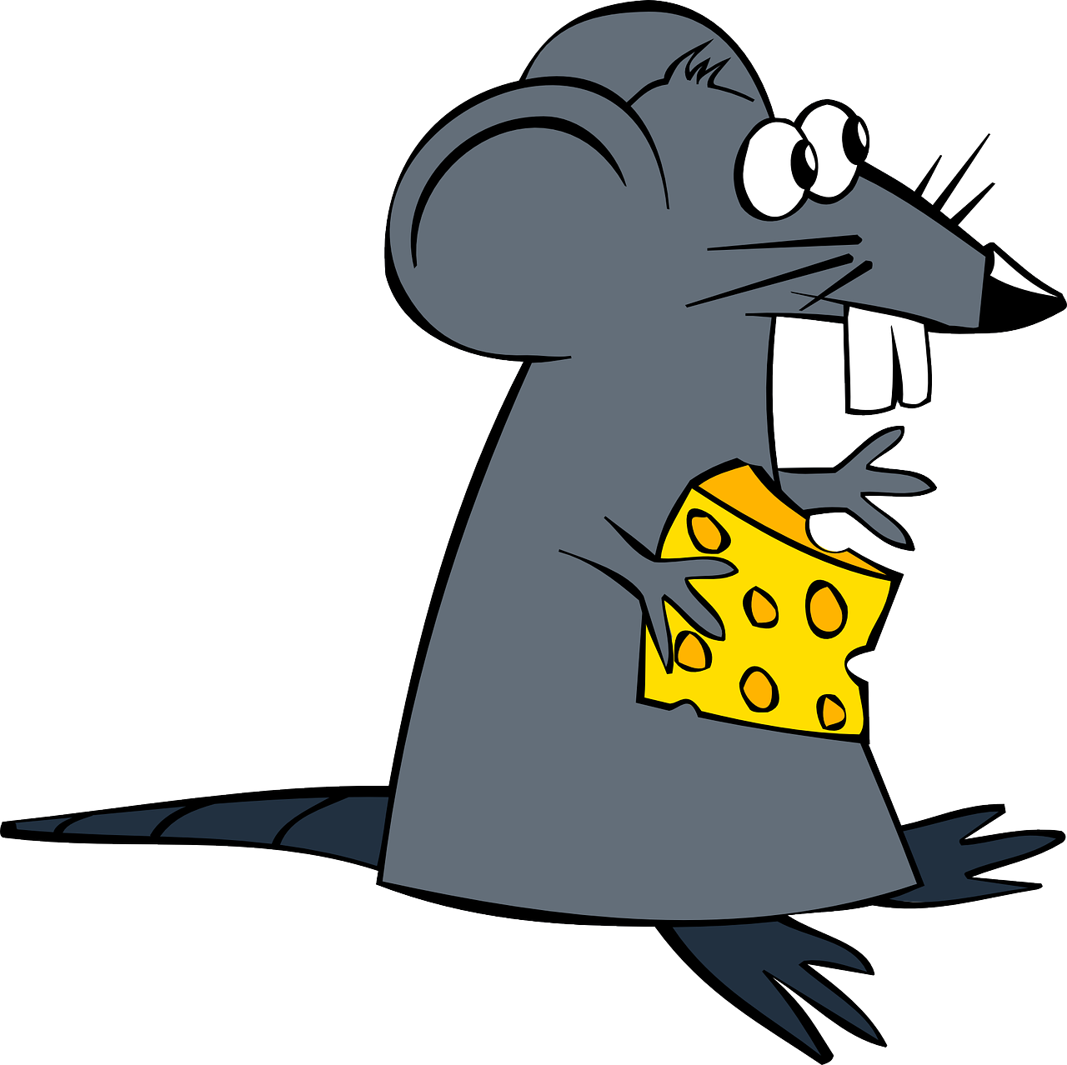
What would happen if rats and cats teamed up?

Slide 10
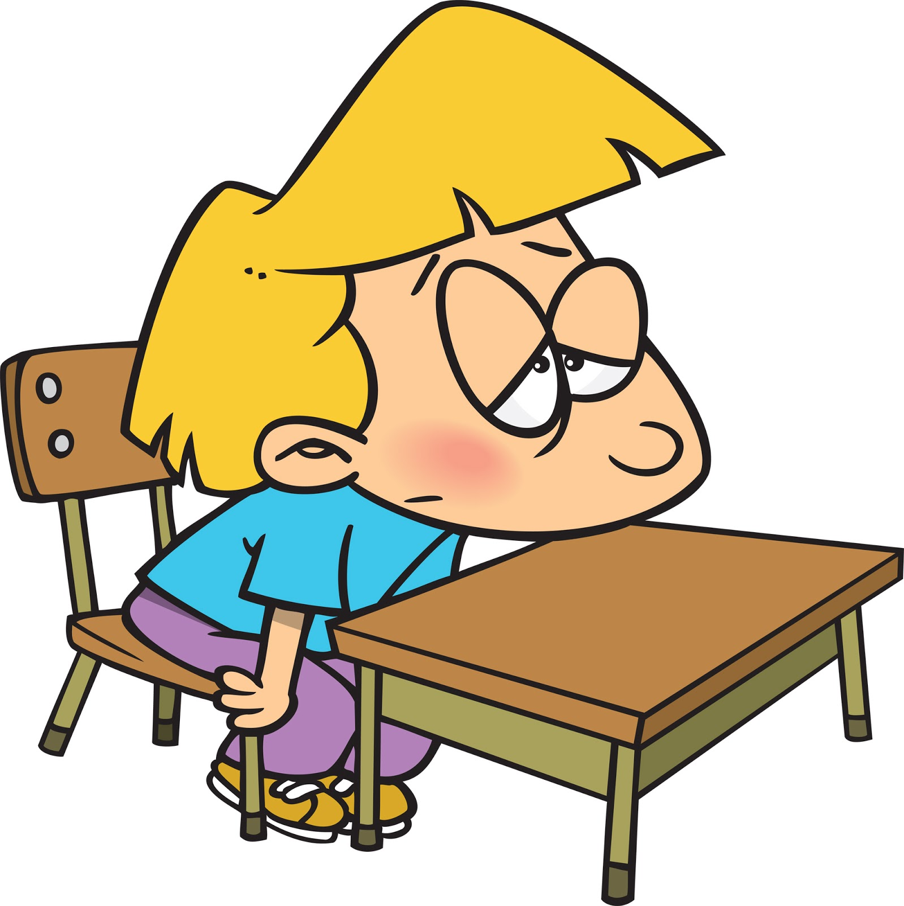
What could never be boring?

Slide 11
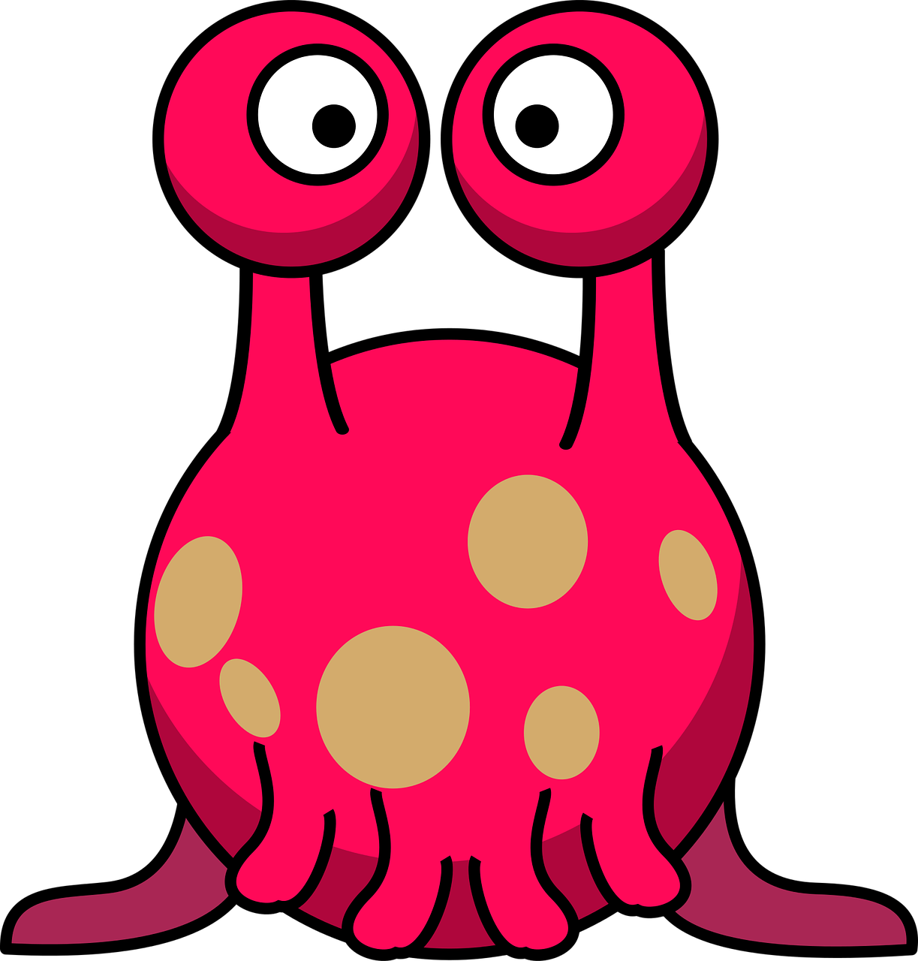
Would you befriend an alien?

Slide 12
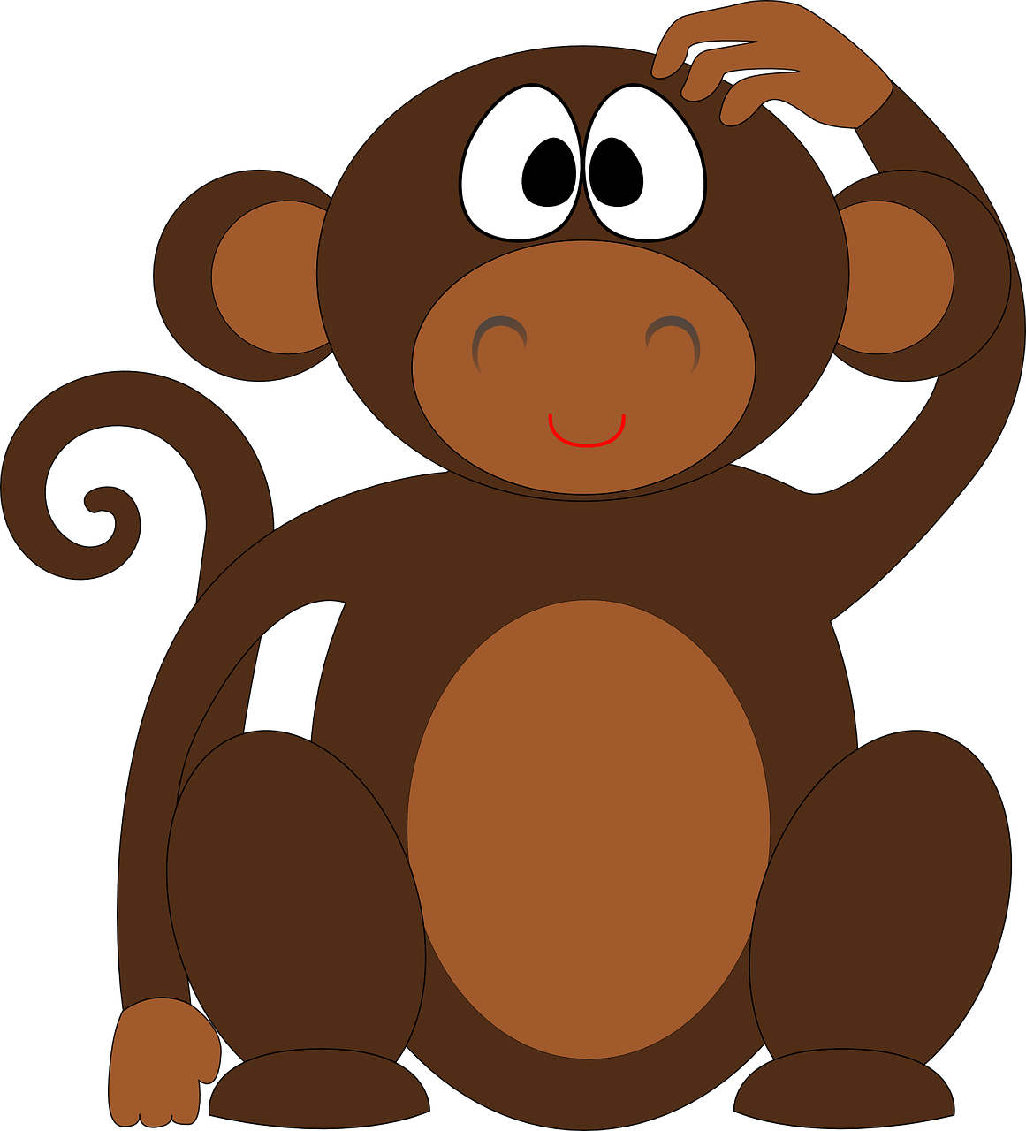
Can animals be naughty?

Slide 13
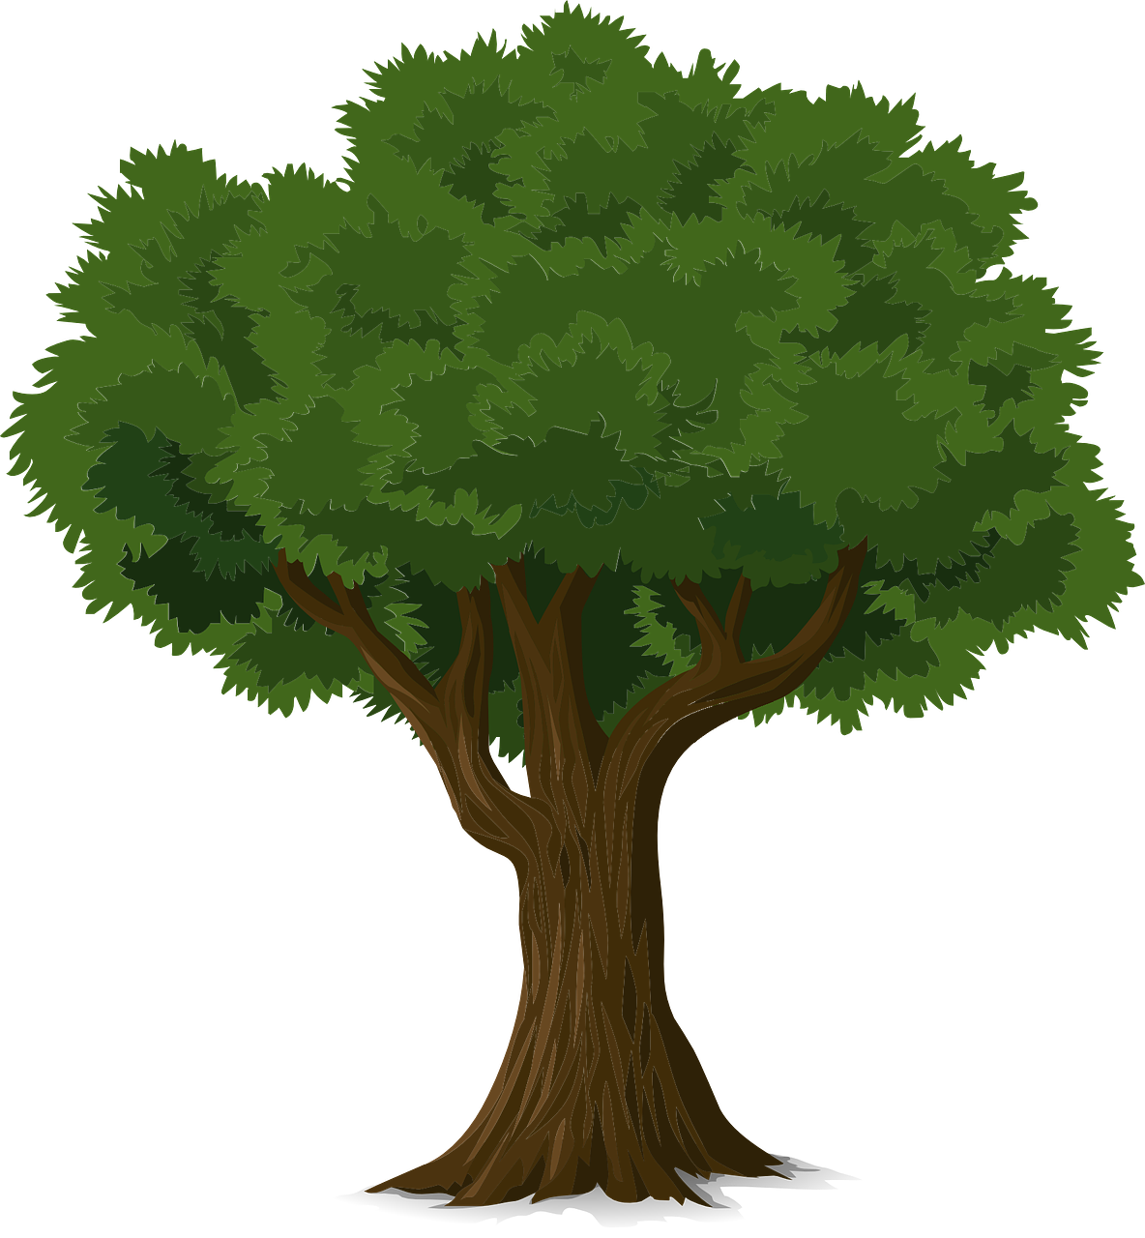

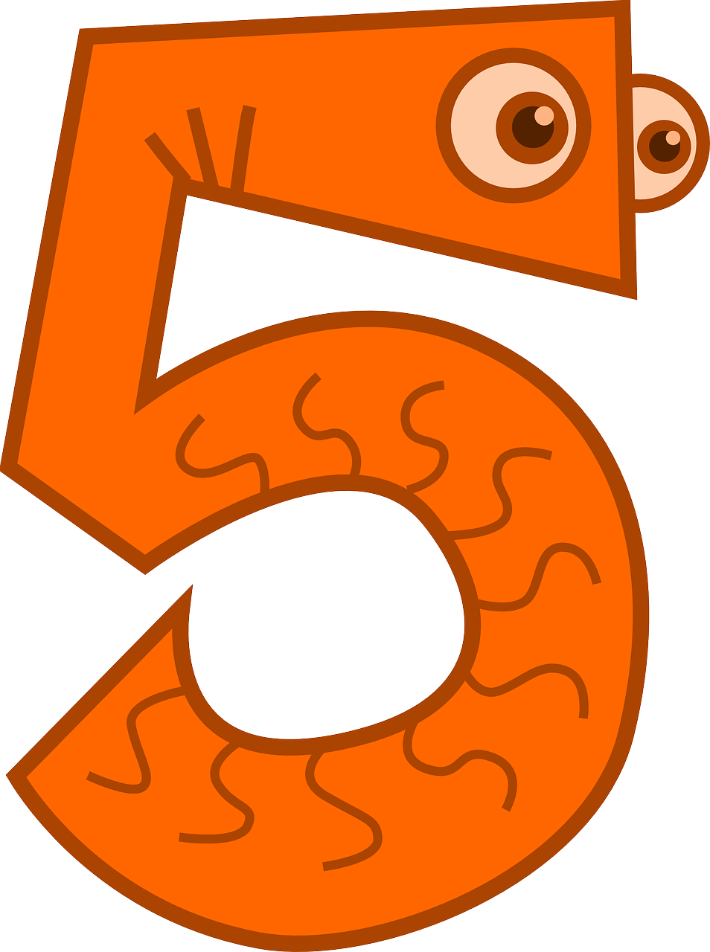

Would a tree be good at Maths?

Slide 14
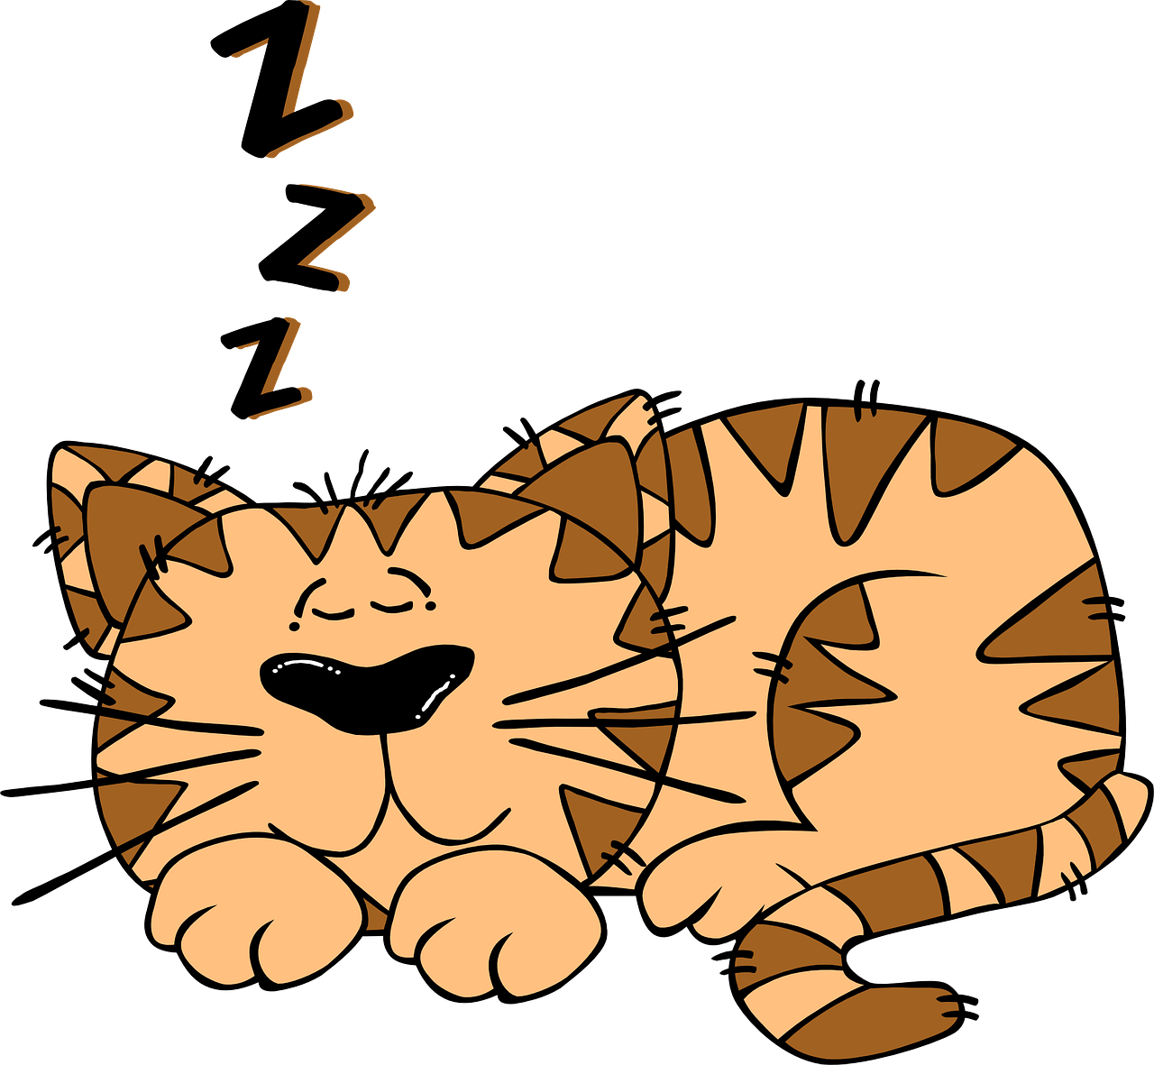
What are dreams made of?

Slide 15
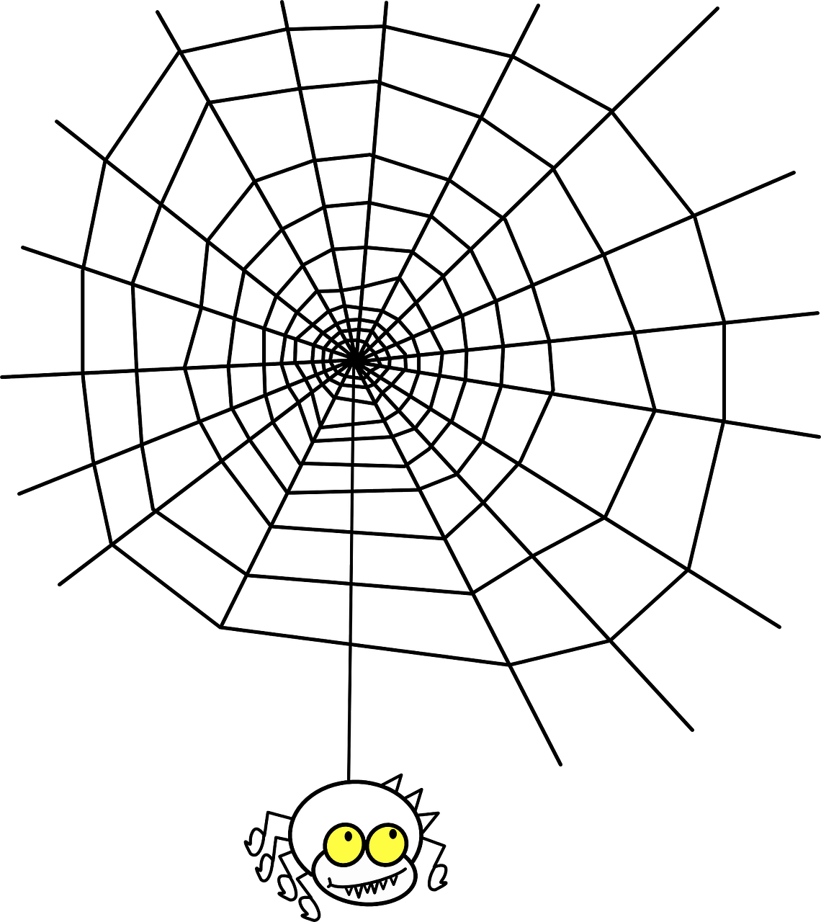

Would you save a butterfly from a spider’s web?

Slide 16

Does your voice still exist when you’re not talking?

Slide 17
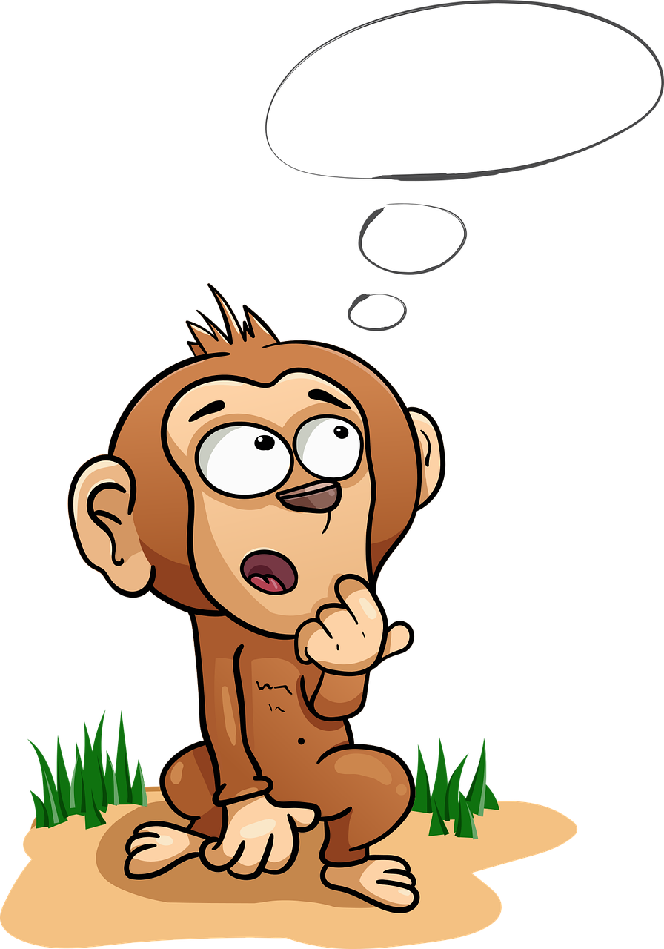
Can you run out of thoughts?

Slide 18
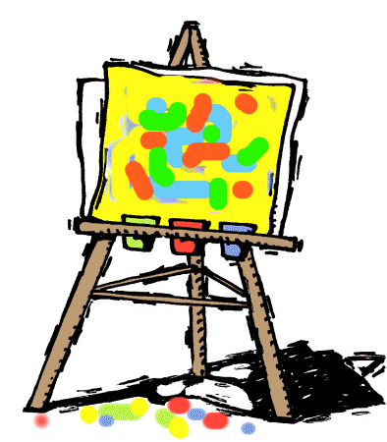
Should art be beautiful?

Slide 19
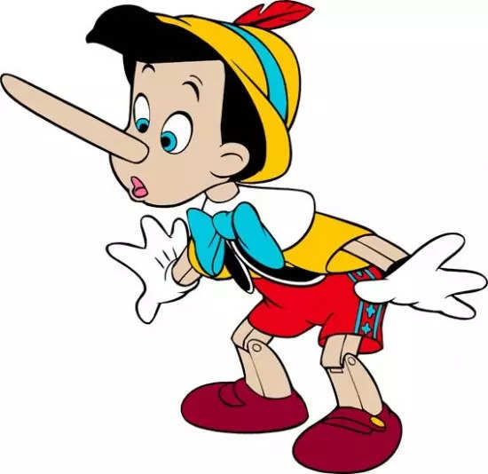
Would the world be better if it contained no lies?

Slide 20



When is real life stranger than fiction?

Slide 21

Is courage a choice?

Slide 22
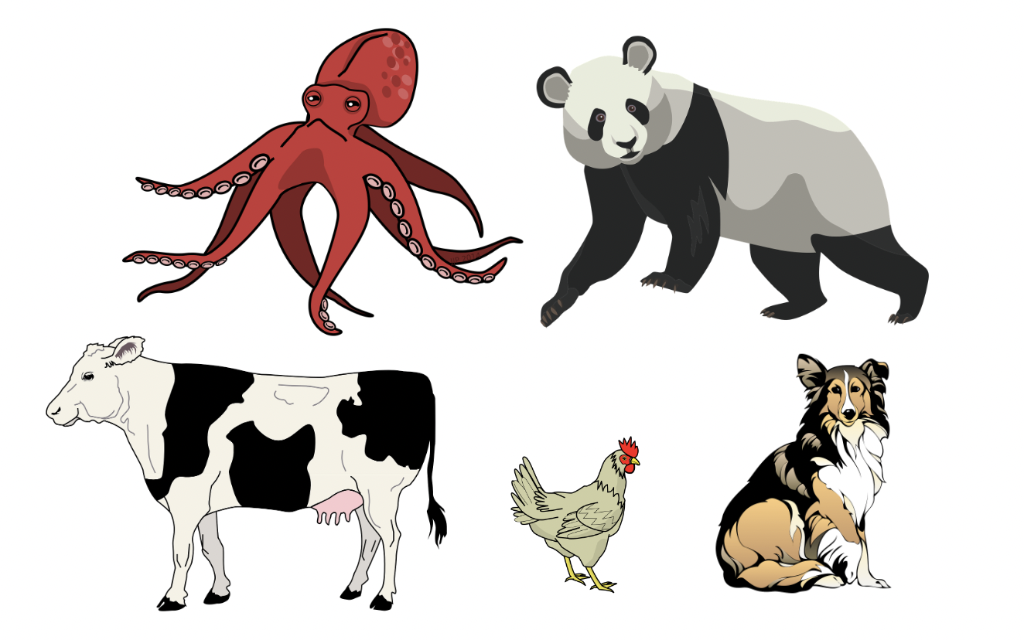
Are some animals’ lives worth more than others?

Slide 23
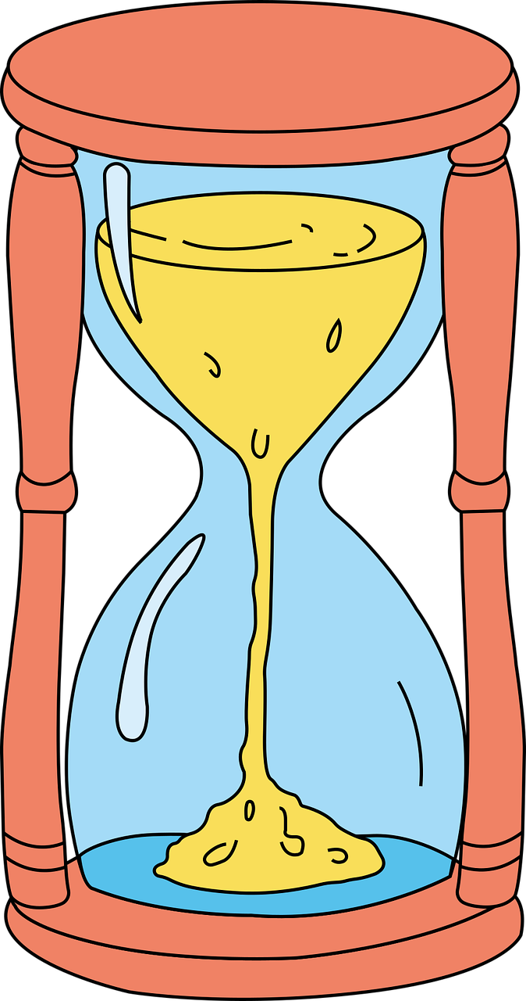
When do you stop being responsible for what you did in the past?

Slide 24
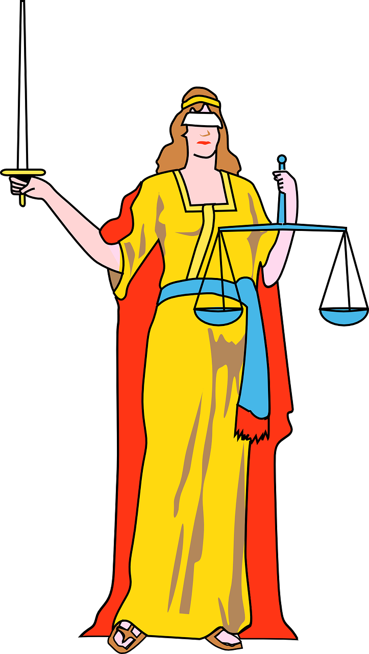
When is revenge justice?

Slide 25
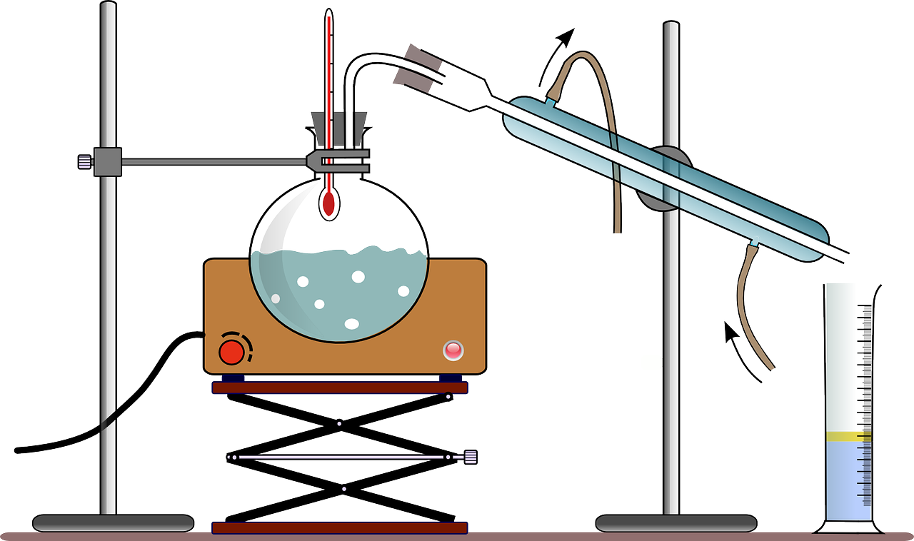
Are there some things scientists should not research?

