Slide 1

Philosophical questions usually involve (explicitly or implicitly) a contestable concept about which people can disagree.

Slide 2
Fairness
Friendship
Happiness
Truth
Justice
Freedom
Bravery
Love
Kindness
Respect
Diversity
Trust
Beauty
Equality
Courage
Wisdom
Empathy
Rights
Dreams
Family
Community
Nature
Peace
Power
Creativity
Curiosity
Belief
Knowledge
Identity
Memory
Change
Growth
Fear
Hope
Time
Reality
Space
Mind
Goodness
Suffering
Justice
Tolerance
Freedom
Authority
Duty
Honour
Loyalty
Tradition
Innovation
Choice
Destiny
Fate
Life
Death
Soul
Spirit
Individuality
Society
Culture
Reason
Logic
Intelligence
Thought
Emotion
Feeling
Sensation
Perception
Imagination
Dream
Fantasy
Reality
Existence
Awareness
Experience
Learning
Education
Skill
Talent
Story
Myth
Legend
History
Future
Universe
Chance

Slide 3
You can ask questions of different
weights of seriousness.
Often light questions will lead to
better engagement but sometimes
heavy questions call forth maturity.

Slide 4
WEIGHT
Playful – If you were completely free to do anything you wanted, what would you do?
Safe – Would you be more free if there were no rules?
Serious – Who are more free, children or adults?
Weighty – Is freedom more important than safety?

Slide 5
Questions can be placed as issues for a range of different people .

Slide 6
PERSON
You personally – Which three freedoms matter most to you?
Generic – Can anyone be completely free?
A role/job – How can teachers make children more free?
Fictional character – Is Private Peaceful free in his last hours?
Society – What is more unstable, a free society or an unfree society?

Slide 7
They can involve looking at an issue
through a wide range of
philosophical lenses.

Slide 8
LENSE
Conceptual – meaning
What is freedom?
Epistemological – knowledge
How do you know you are free?
Phenomenological – experience, perception
What is it like to be free?
Evaluative – importance, good and bad
How important is freedom?

Slide 9
LENSE
Evaluative – importance, good and bad
How important is freedom?
Metaphysical – reality, identity, properties
Do societies have freedom, or only individuals?
Criterialogical – examples, patterns
When can someone be described as free?
Evaluative – importance, good and bad
How important is freedom?

Slide 10
LENSE
Hermeneutic – interpretation
“Man is born free but he is everywhere in chains.” What does it mean?
Paradigmatic – ultimate, essence of
What would be ultimate freedom? Is true freedom possible?
Taxonomic
What different sorts of freedom are there?
Concept mapping – defining against neighbouring concepts
How do “freedom” and “wanting” relate to each other?

Slide 11
LENSE
Concept mapping – defining against neighbouring concepts
How do “freedom” and “wanting” relate to each other?
Quantificational – all, some, most, none
Is freedom always good for happiness?
Counterintuitive – looking for good in the bad or vice versa
When is freedom a bad thing?
Concept mapping – defining against neighbouring concepts
How do “freedom” and “wanting” relate to each other?

Slide 12
LENSE
Distributive – sharing out x between ys
How much of freedom is nobody stopping you, and how much is being able to start?
Character-based – fictional, scriptural or historical
Is “anything possible” for Pixie?
Analytic – breaking x down
What are the must-have ingredients of freedom?

Slide 13
You can find the philosophical
in almost any topic.

Slide 14
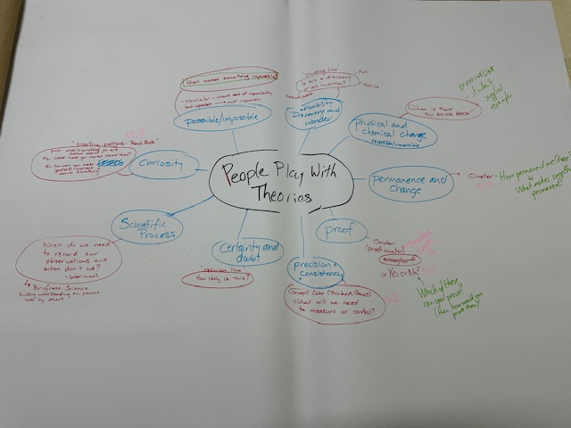

Slide 15
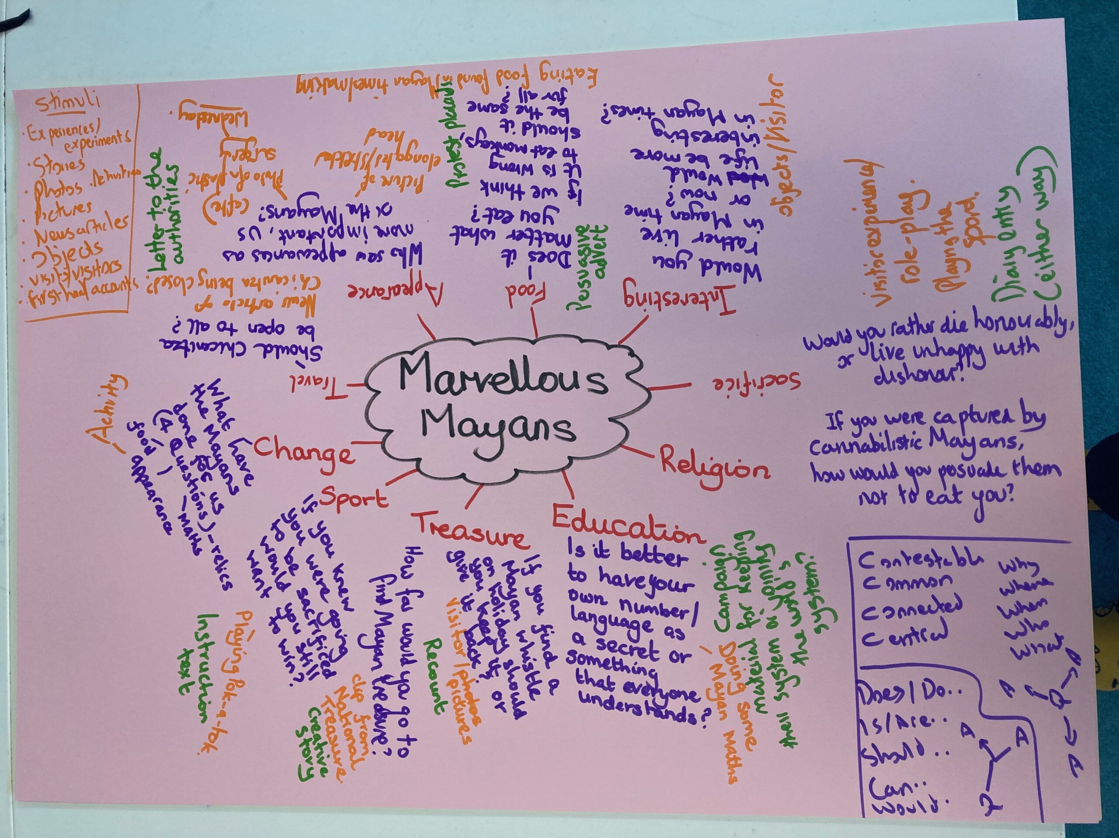

Slide 16
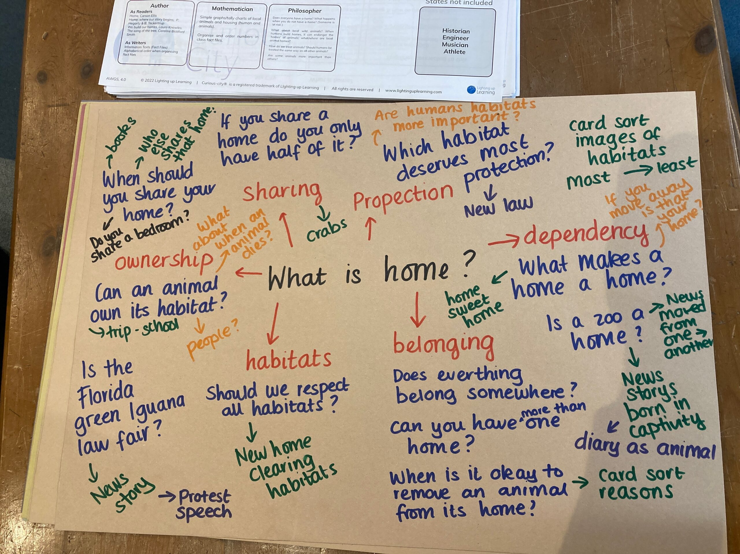

Slide 17
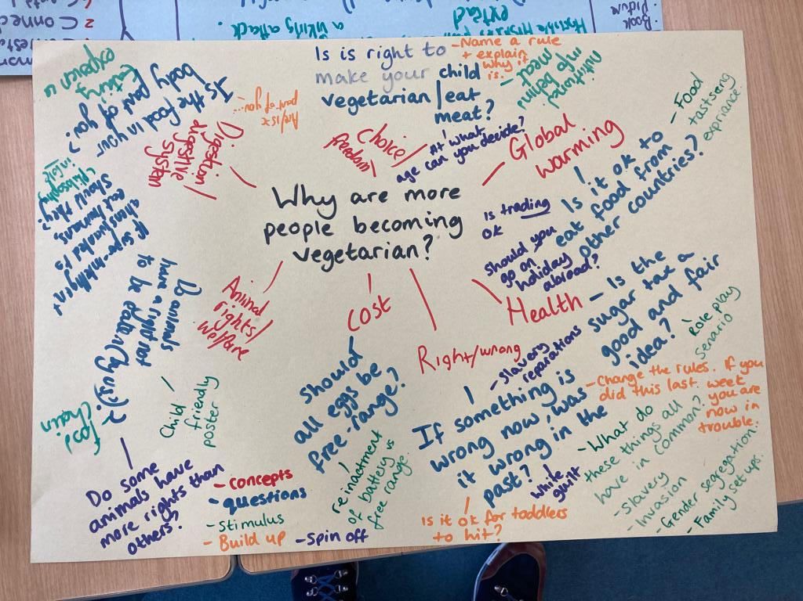

Slide 18
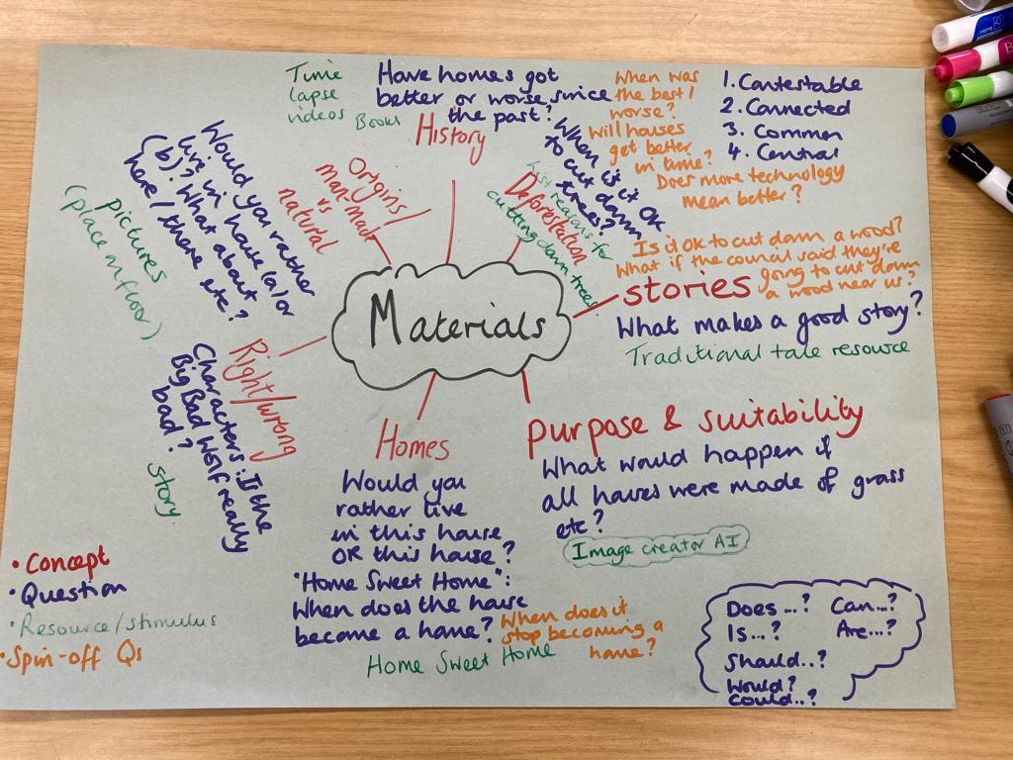

Slide 19
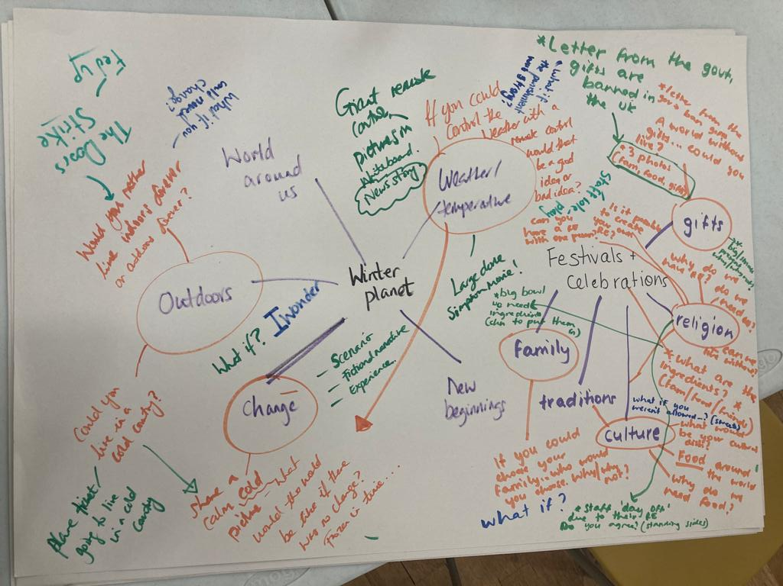

Slide 20
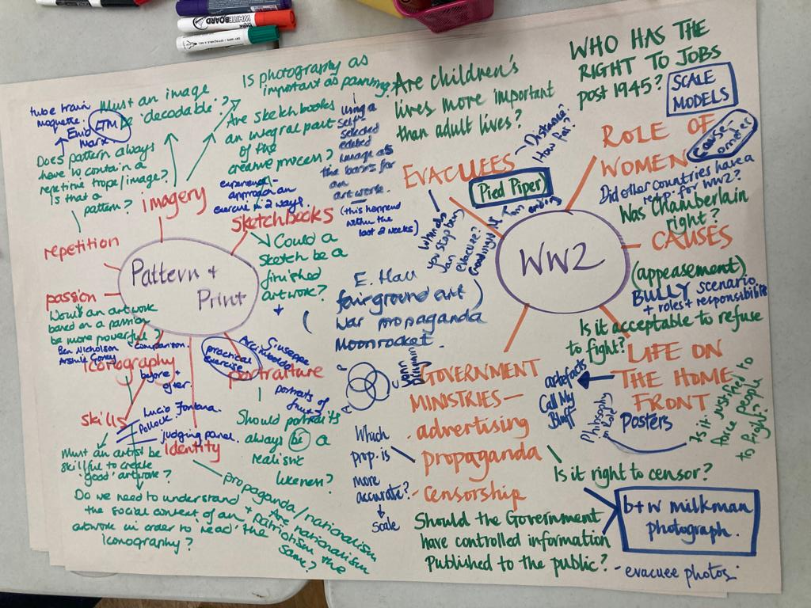

Slide 24
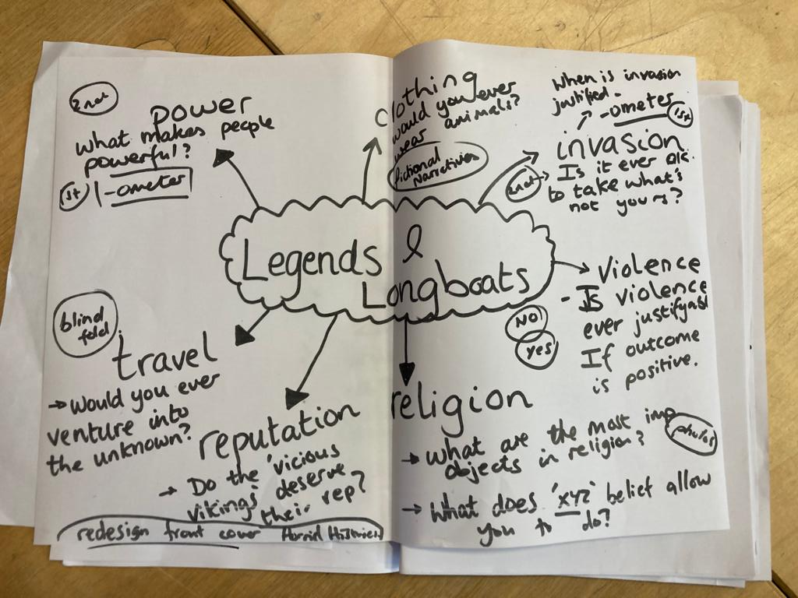

Slide 25
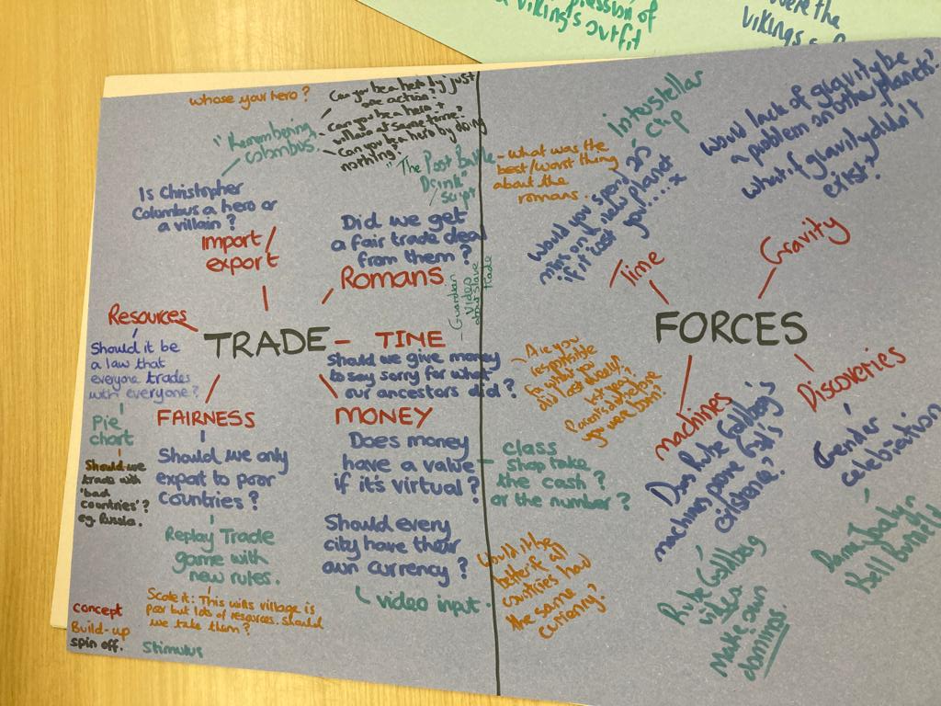

Slide 26
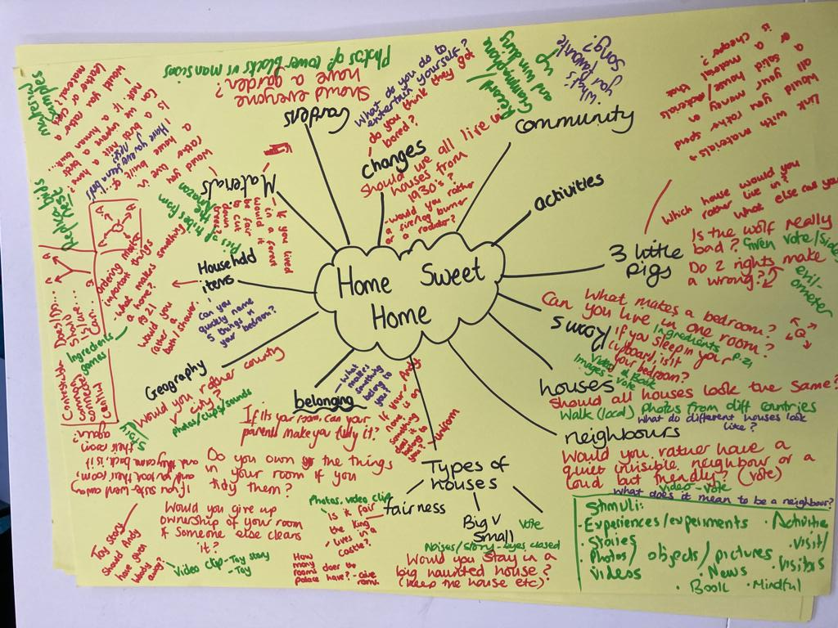

Slide 27
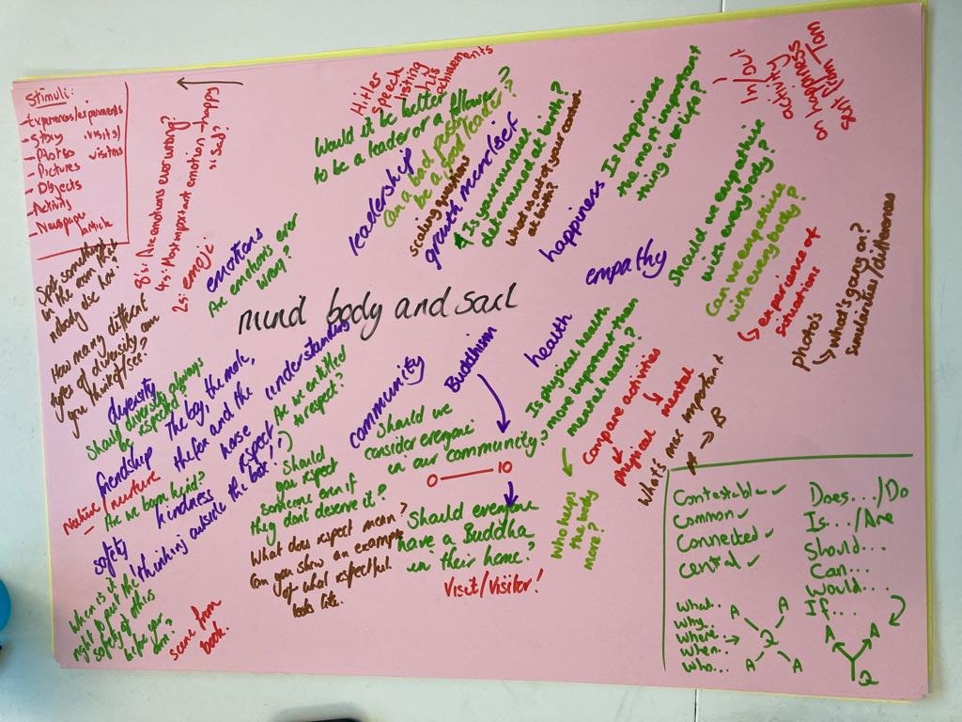

Slide 28
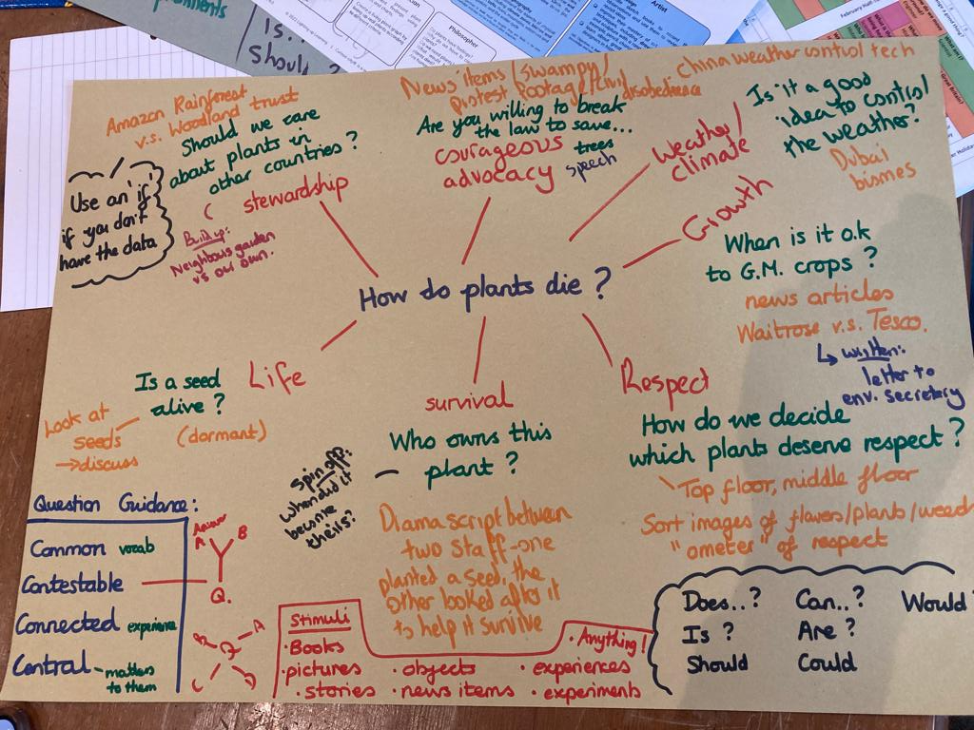

Slide 29
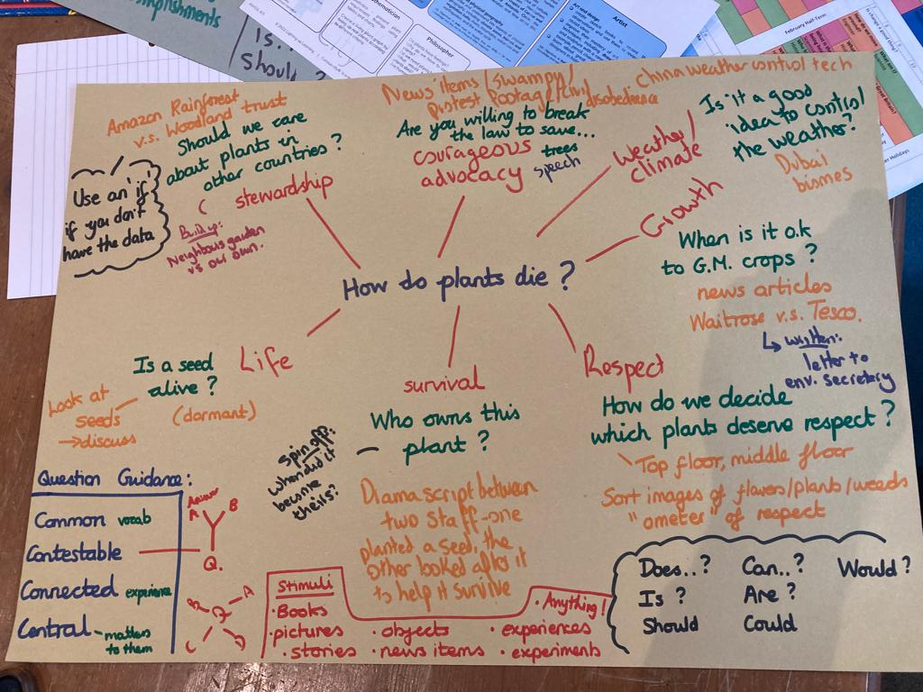

Slide 30


Slide 31
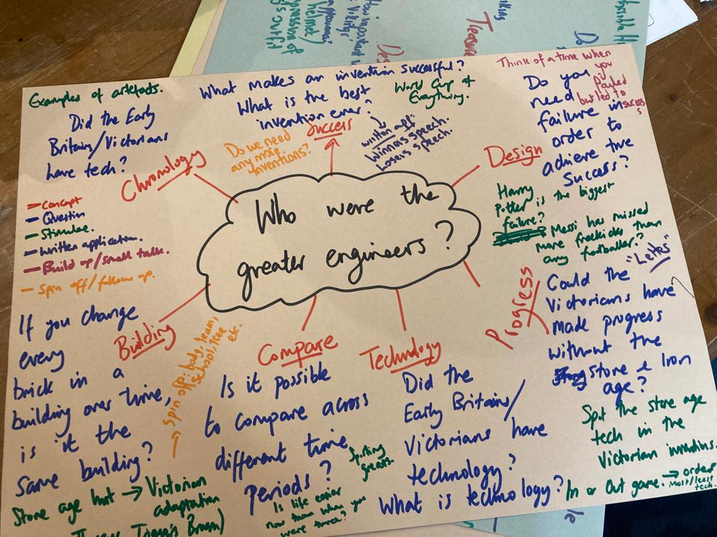

Slide 32
Harry Potter
Desire | Belonging | Courage
Do our desires make us happy or unhappy? | When is it OK to sort people? | What is bravery?
What would each character see in the Mirror of Erised? | Sorting Hat – randomly allocated groups thought experiment | Brave-ometer from different “brave/cowardly” events in the story
Concept
Questions
Stimuli
Notes:
Can really do it in any order. Concepts before questions good, because it can make questions more accessible. Less ‘where did the cats go’?
Stimuli - should provoke thinking, not tell them what to think. Not here to proselytise or preach. They will get enough of that in assemblies.
Concepts can be used to make science/maths/abstract topics more human - e.g. on minibeasts, introduce the concepts of fear, disgust, phobias?

Slide 33
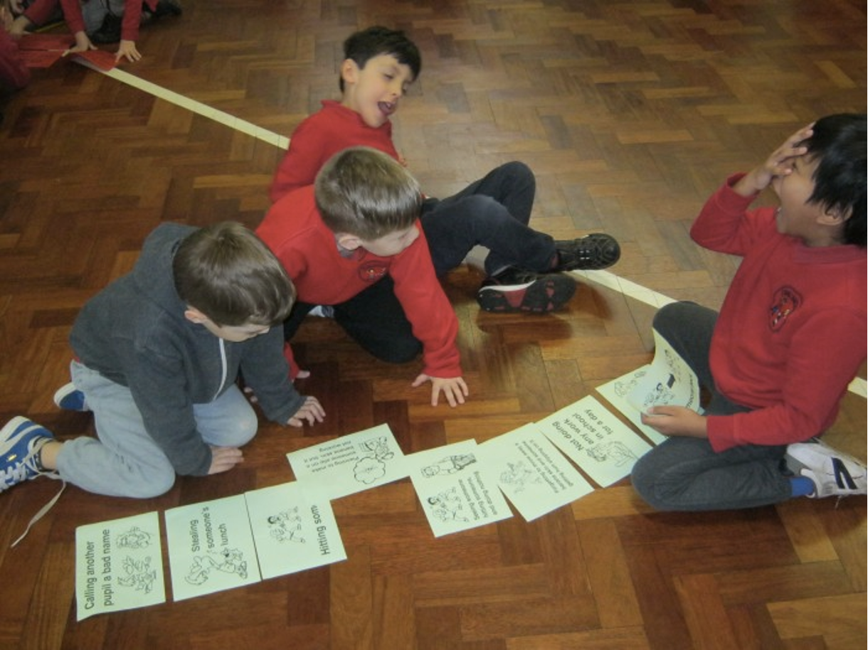

Slide 34
War
Conscription | Animal welfare | Goodies and baddies
Should anyone ever be forced to fight? | Should animals be used in war? | Can you be a good person but fight for an evil leader?
Philosophy in role | Starting Positions (2s, 4s, 8s) | Vote with your feet
Concept
Questions
Stimuli
Notes:
Can really do it in any order. Concepts before questions good, because it can make questions more accessible. Less ‘where did the cats go’?
Stimuli - should provoke thinking, not tell them what to think. Not here to proselytise or preach. They will get enough of that in assemblies.
Concepts can be used to make science/maths/abstract topics more human - e.g. on minibeasts, introduce the concepts of fear, disgust, phobias?

Slide 35
Toys
Children | Imagination | Play
What makes something ‘grown up’? | Why do we pretend? | Would it be dull to play forever?
Bringing in a children’s toy and an adult gadget | Story of a boy who couldn’t pretend | Peter Pan and the lost boys
Concept
Questions
Stimuli
Notes:
Can really do it in any order. Concepts before questions good, because it can make questions more accessible. Less ‘where did the cats go’?
Stimuli - should provoke thinking, not tell them what to think. Not here to proselytise or preach. They will get enough of that in assemblies.
Concepts can be used to make science/maths/abstract topics more human - e.g. on minibeasts, introduce the concepts of fear, disgust, phobias?

Slide 36
Rivers
Safety | Pollution | Water cycle
Should you be allowed to settle near a river? | Who is responsible for keeping rivers clean? | Where does the water cycle begin?
Newsclip before/after flood | Pictures of polluted waters | Act out the water cycle
Concept
Questions
Stimuli
Notes:
Can really do it in any order. Concepts before questions good, because it can make questions more accessible. Less ‘where did the cats go’?
Stimuli - should provoke thinking, not tell them what to think. Not here to proselytise or preach. They will get enough of that in assemblies.
Concepts can be used to make science/maths/abstract topics more human - e.g. on minibeasts, introduce the concepts of fear, disgust, phobias?

