Slide 1
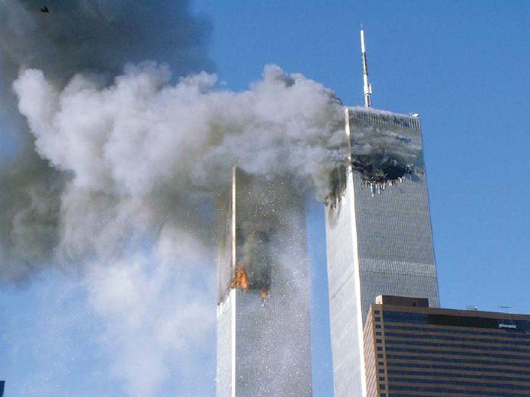
T/P/S: Can this ever be forgiven?

Slide 2
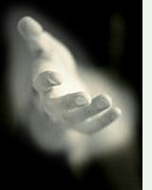
20th November 2012
Forgiveness
LO: To know about forgiveness
To consider why some people forgive
Is there anyone you will never reach out to?
Why?

Slide 3
Forgivable? Being cheated on An act of terrorism Having your beliefs made fun of Being bullied A friend grassing you up Being burgled A parent reading your diary A family member being killed

Slide 4
The power of forgiveness
http://www.youtube.com/watch?v=o2BITY-3Mp4

Slide 5
Was Mary Johnson right to forgive her son’s killer? Write your answers on a post-it with a reason
ABSOLUTELY NOT AT ALL

Slide 6
Write a letter to Mary giving your views about her decision to forgive Oshea.
Was she right?
What would you have done in this situation?

Slide 7
Homework
Complete the worksheet about the forgiveness quotes
Deadline: Next lesson

Slide 8
“Forgiveness warms the hearts and cools the sting.”
“Humanity is never so beautiful as when praying for forgiveness, or else forgiving another.”
“When you forgive, you in no way change the past - but you sure do change the future.”

